Slide 1

REAL-TIME ANALYTICS DASHBOARD
USING AZURE DATABRICKS & PYSPARK
- Ragavi Venugopal

Slide 2

Agenda
Project Statement
Objectives
Architecture & Data
Implementation
Results & Optimizations
Conclusion

Slide 3

Project Statement
Build a real-time analytics dashboard for cryptocurrency markets.
Ingest data from Binance API.
Process data using Azure Databricks + PySpark.
Provide auto-updating visual insights for traders & analysts.
API
Processing
Dashboard

Slide 4
PROJECT DETAILS

Slide 5
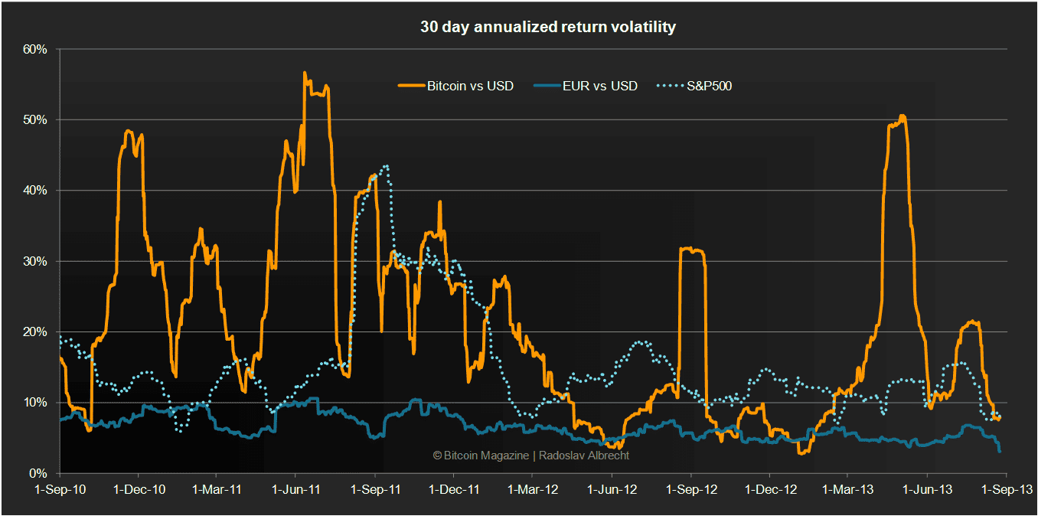
Project Overview
Why? Cryptocurrency is highly volatile & runs 24/7.
Need real-time monitoring for decision-making.

Slide 6
Project Overview
Pipeline Components:
Data Source: Binance API
Ingestion: Azure Databricks
Processing: PySpark Structured Streaming
Visualization: Matplotlib, Plotly, Power BI
Outcome: Actionable, real-time crypto insights.
Data ingestion
Streaming processing
Visualization
API
Processing
Dashboard

Slide 7
Project Objectives
Real-Time Data Ingestion: Fetch live cryptocurrency data from Binance API.
Stream Processing: Process continuous data efficiently with PySpark.
Compute Insights: Calculate moving averages, RSI, volatility, and other market metrics.
Interactive Dashboard: Auto-refreshing charts, price ranges, volume, sentiment, and performance tables.
Azure Databricks Integration: Scalable cloud-based computation for distributed processing.
Efficiency & Optimization: Vectorized operations and optimized plotting for high performance.

Slide 8
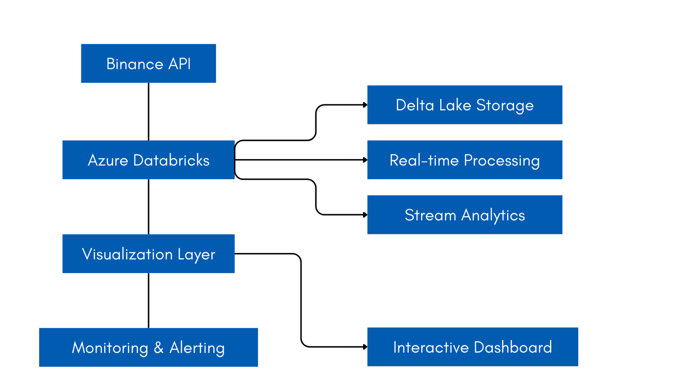
Architecture Diagram

Slide 9


Data Source: Binance API
Provides tick-level data:
Prices
Volumes
Order Book
{
"symbol": "BTCUSDT",
"price": "50123.45",
"volume": "12345.678"
}
binance_api_url = "https://api.binance.us/api/v3/ticker/24hr"

Slide 10
Data Schema
{
"symbol": "BTCUSDT",
"price": "50123.45",
"volume": "12345.678",
"priceChange": "125.67",
"priceChangePercent": "0.25",
"highPrice": "50200.00",
"lowPrice": "49900.50",
"quoteVolume": "619382049.89",
"timestamp": 1633034400000
}
symbol: STRING (Primary key)
price: DOUBLE
volume: DOUBLE
priceChange: DOUBLE
priceChangePercent: DOUBLE
highPrice: DOUBLE
lowPrice: DOUBLE
quoteVolume: DOUBLE
event_time: TIMESTAMP
processing_time: TIMESTAMP
date: DATE
hour: INT

Slide 11
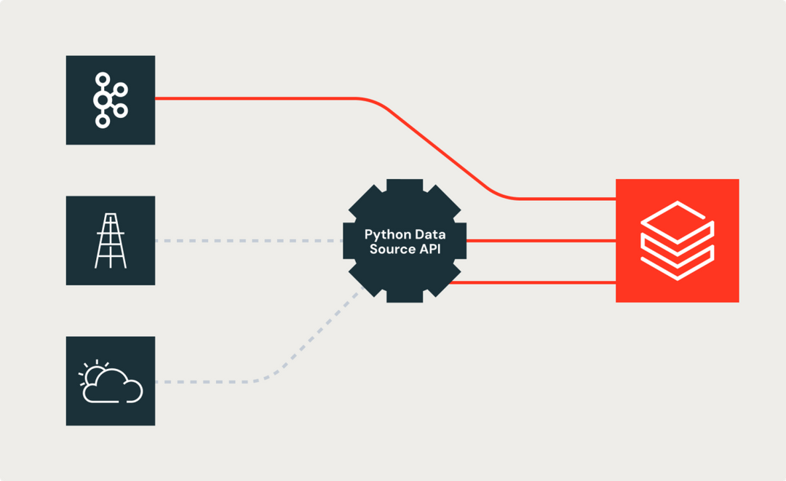
Data Ingestion
Stream data pulled continuously.
Azure Databricks handles updates at second/minute intervals.

Slide 12
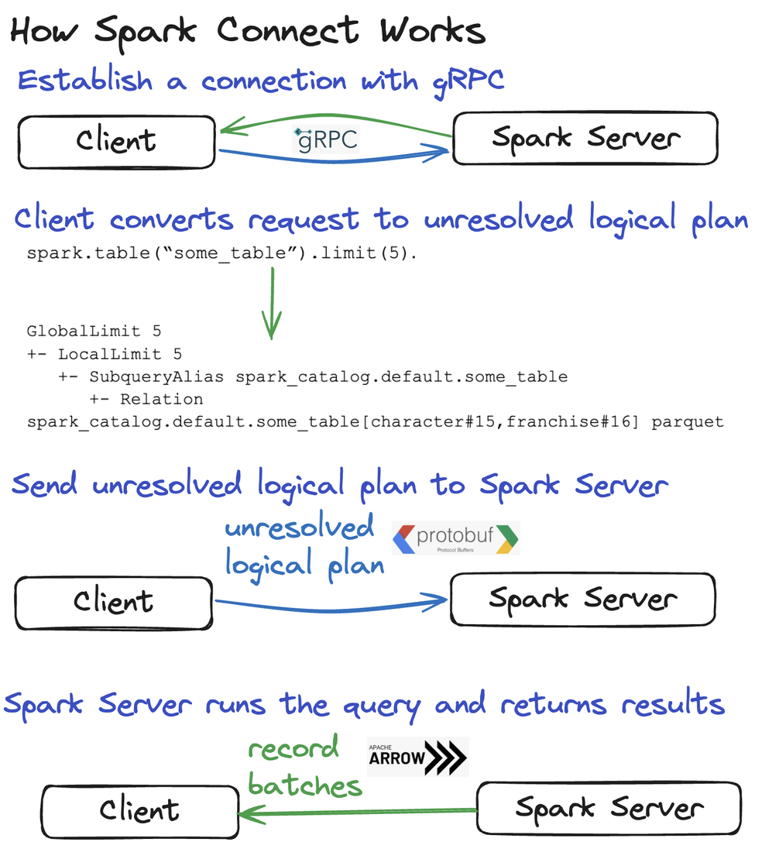
Processing Layer
Cleans & transforms raw tick data.
Computes:
Moving Averages
Volatility Index
% Price Changes

Slide 13
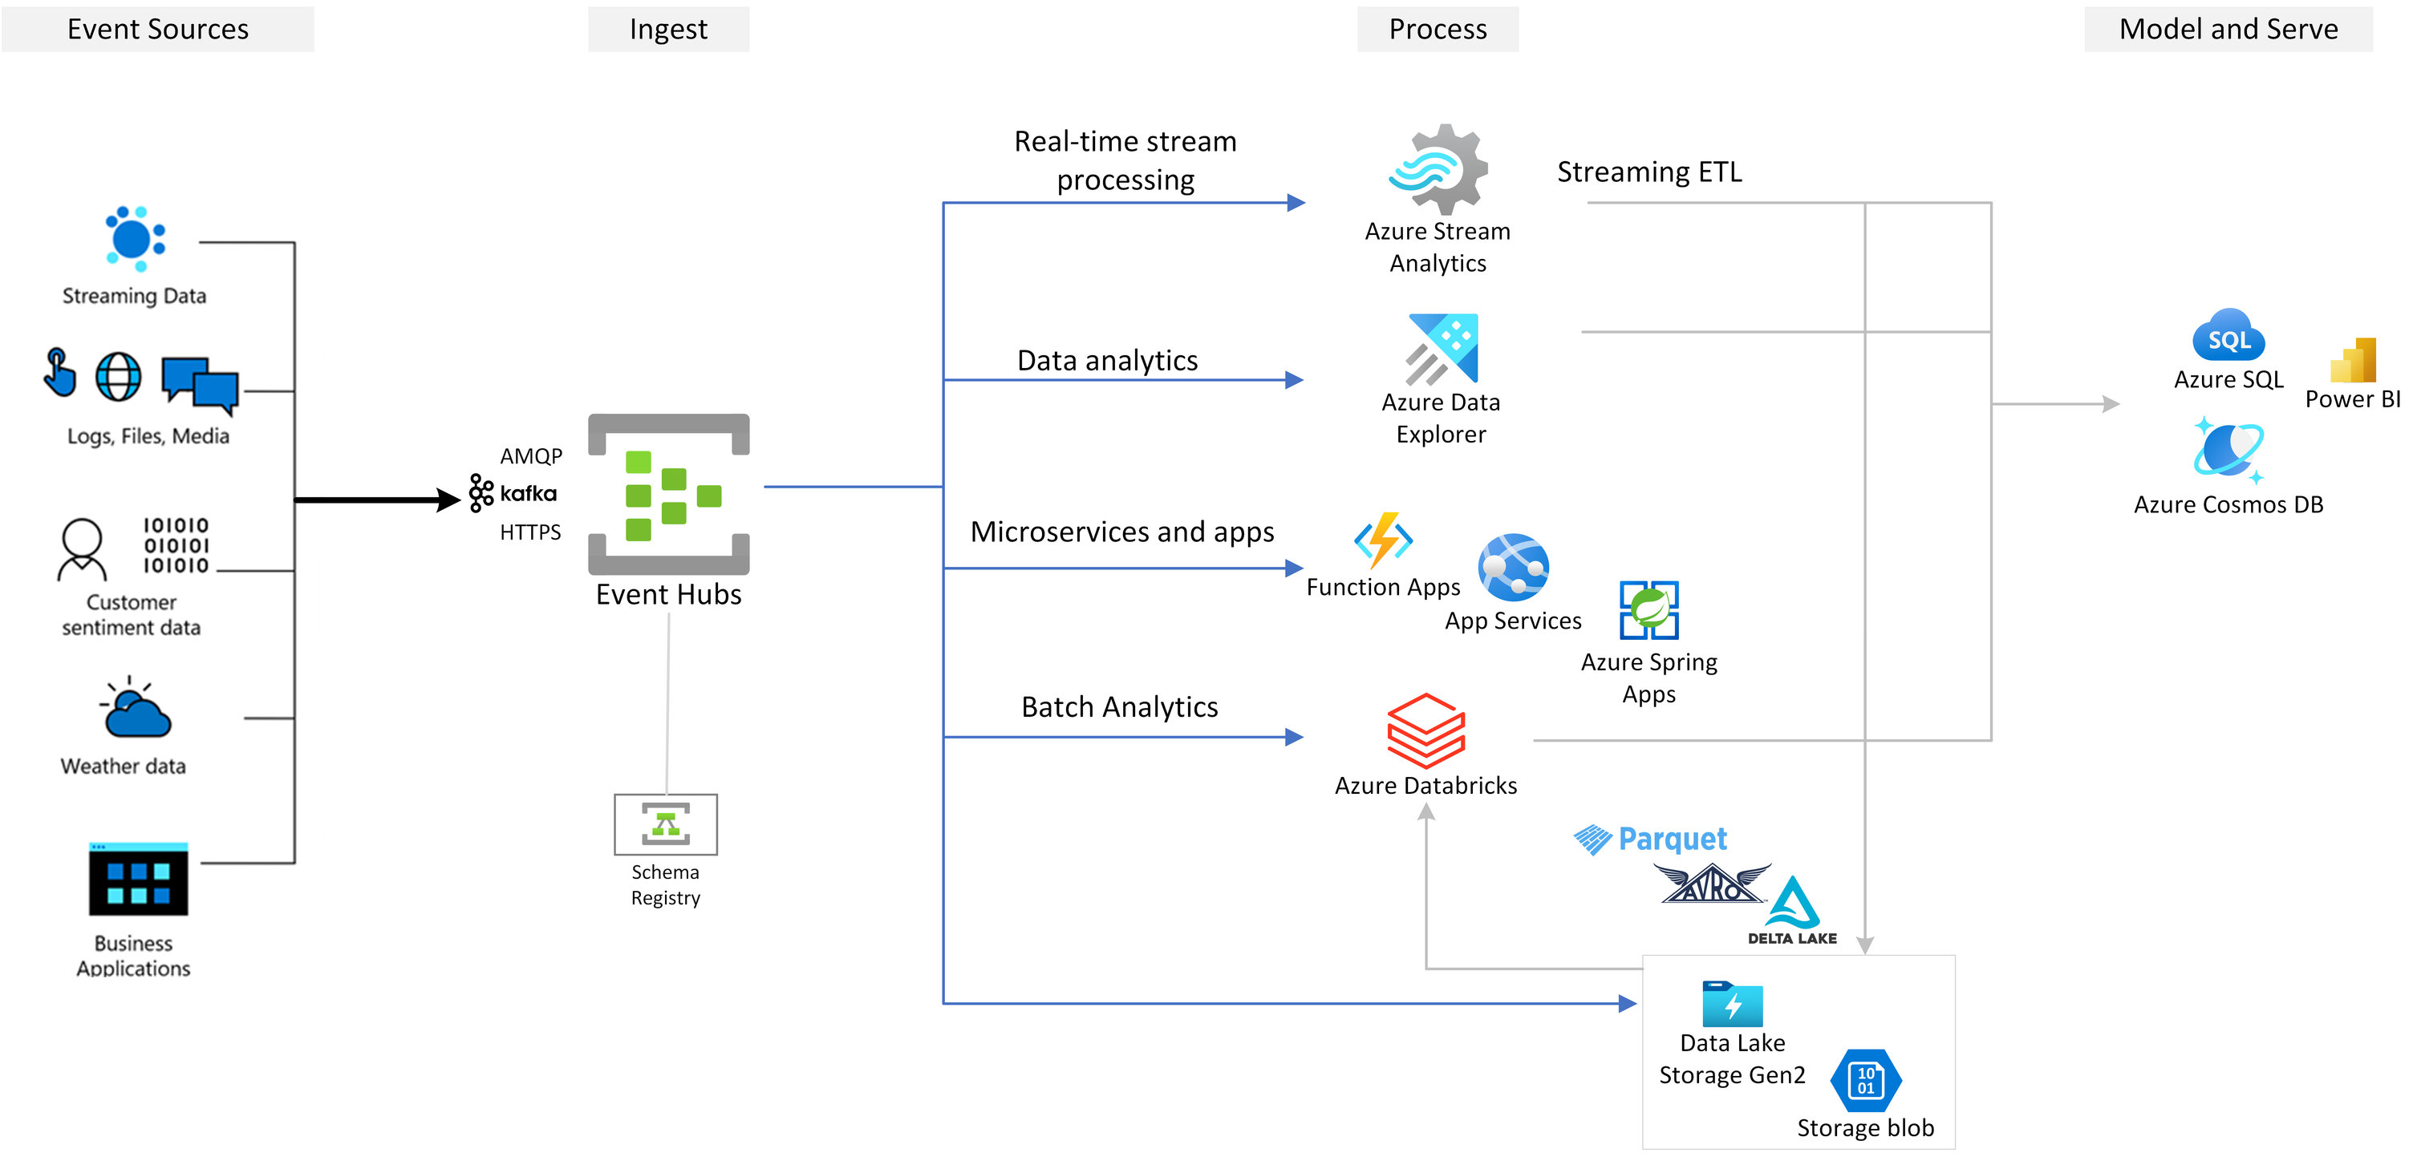

Slide 14
Visualization Layer
Dashboards include:
Candlestick charts (price movement)
Line graphs (moving averages)
Volume bar charts
Sentiment pie chart
Auto-refresh enabled.

Slide 15
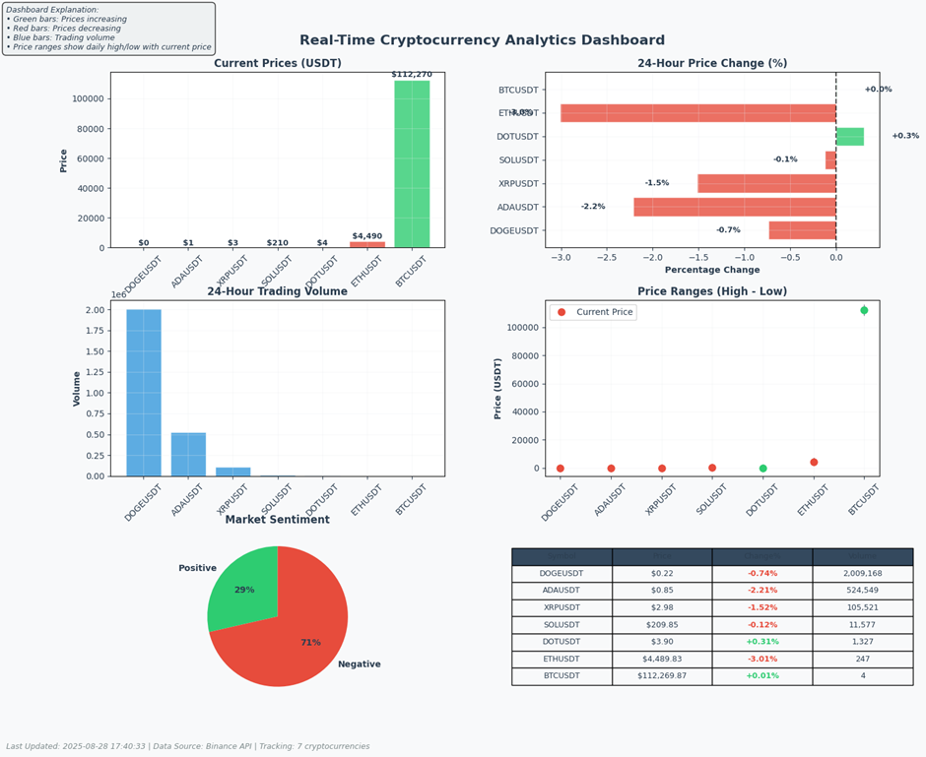

Slide 16

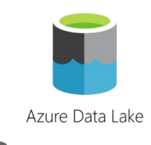
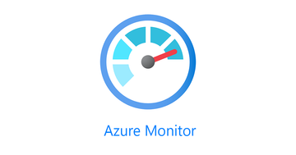
Azure Resources Used
Databricks Workspace – streaming jobs.
Storage (Delta Lake) – persistent storage
Azure Monitor – performance metrics.

Slide 17





Tools & Technologies
Azure Databricks, PySpark, Spark SQL.
Matplotlib / Plotly.
Pandas.
Binance API.
Delta Lake.

Slide 18
IMPLEMENTATION

Slide 19
How It Works
Data Ingestion → Binance API into Databricks.
Stream Processing → PySpark transformations
Storage → Delta Lake for historical analysis.
Analytics → Moving averages, volume spikes, volatility.
Visualization → Real-time dashboard.

Slide 20
Execution Flow
Setup Databricks workspace & cluster.
Develop ingestion pipeline.
Process data with PySpark SQL.
Create visualizations.
Enable auto-refresh & monitoring.

Slide 21
Azure Setup
Create account → Resource Group → Event Hub → Databricks Workspace.

Slide 22
Databricks Setup
Create cluster.
Install Python libraries.
Create notebooks.

Slide 23
Data Fetching
Fetch Binance Data (Python).
Process with PySpark.
Build dashboard graphs.

Slide 24
RESULTS & ANALYSIS

Slide 25
Analysis Results
Price monitoring (color-coded).
Performance analysis (gainers/losers).
Volume analysis.
Volatility & sentiment tracking.

Slide 26
Tasks Performed
Azure environment setup.
API integration.
PySpark processing.
Delta Lake storage.
Dashboard development.
Spark SQL queries.
Automation.

Slide 27
Sample Dashboard

Slide 28
Optimization Strategies
Cluster auto-scaling.
Delta Lake caching.
API connection pooling.
Visualization incremental updates.
Cost optimization via auto-termination.

Slide 29
Conclusion
Achieved real-time analytics dashboard.
Demonstrated Azure + Databricks + PySpark integration.
Scalable design, reliable architecture.
Provides actionable insights for crypto trading.

Slide 30
Thank you very much!
PRESENTED BY

